Slide 1


SOMERSET PURPOSE
Somerset Academy, Inc. promotes a transformational culture that maximizes student achievement and the development of accountable, global learners in a safe and enriching environment that fosters high-quality education.
S - Set high expectations
O - Objective
M - Meaningful curriculum
E - Effective
R - Resourceful and responsible life long learners
S - Scholars who achieve proficiency and beyond
E - Evaluate continuously and use data to drive curriculum
T - Teachers who are highly qualified

Slide 2

NO FOOD ON THE COURT

Slide 3
DO NOT. . .
“Hang out” in the stairwells or on the second floor during lunch.
Chew gum. DO NOT BRING GUM!
Go on the basketball court with a skateboard!
Use the elevator without approval from the office.
Leave campus if you are a Middle Schooler, Freshman or Sophomore (Except for DE students)
Allow an underclassmen in your vehicle without prior permission, or you will lose all privileges for the remainder of the school year.
Throw anything off the balcony.
Throw anything from the ground level to the 2nd floor.
Eat or carry food over the basketball court or turf field
Litter or leave garbage around at lunch
Hang out by the wavy wall side or behind the basketball court bleachers
Hang on or grab the basketball nets/rims
Playing “keep away” = a detention
Yoga pants/ leggings/ are not allowed. Not even during dress down days. Dress code violations earn detentions
You are not to go to the Deans’ office during class to argue a detention. You will be turned away.

Slide 4
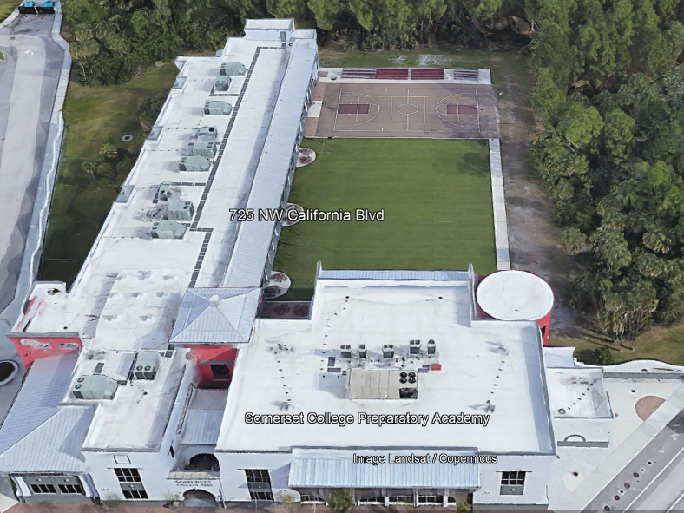

There is NO open food or liquid on the turf!!!
If you are caught, you will be having a meeting with the deans
TURF!

Slide 5
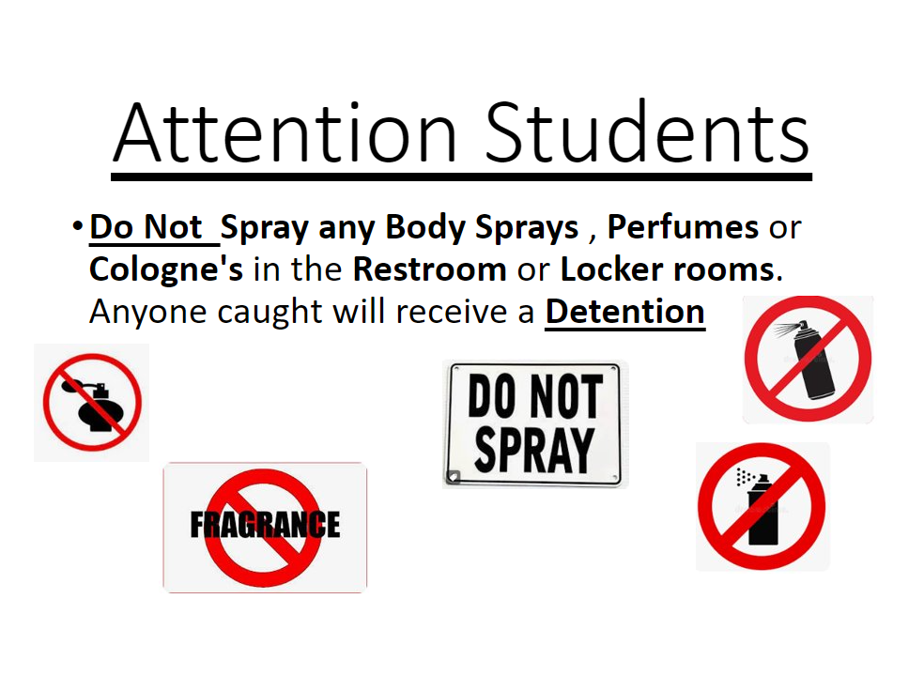

Slide 6

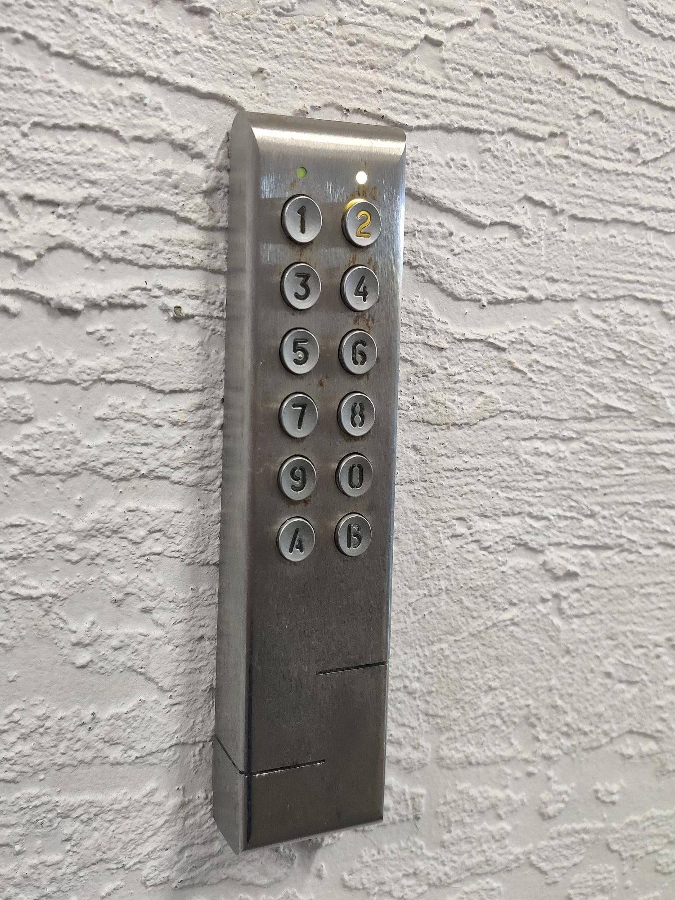
Your Door Code Is The Same as your Lunch Number
Door codes for new students should be ready by the end of this week

Slide 7
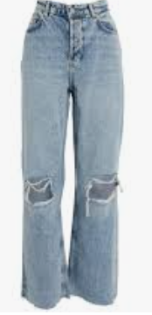



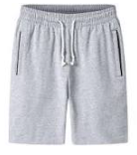
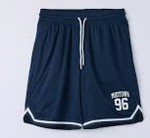

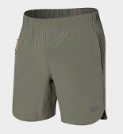

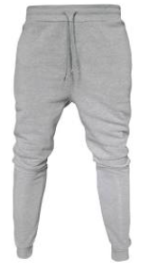


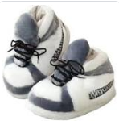


Dress Code Violations (Do Not Wear)
Ripped or Frayed Jeans
Non - Somerset, Hoodies or Polos
Basketball Shorts
Crocs, Slides, Foam Runners & UGG's
Sweatpants, Joggers, Yoga pants, tights or Pajama pants

Slide 8
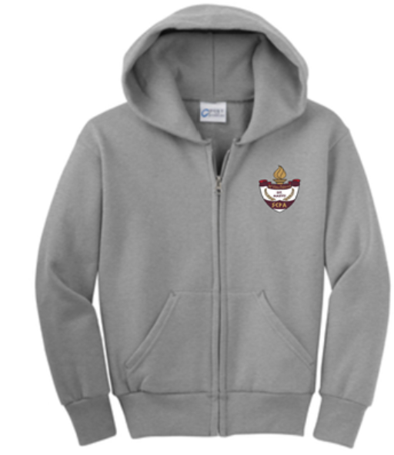
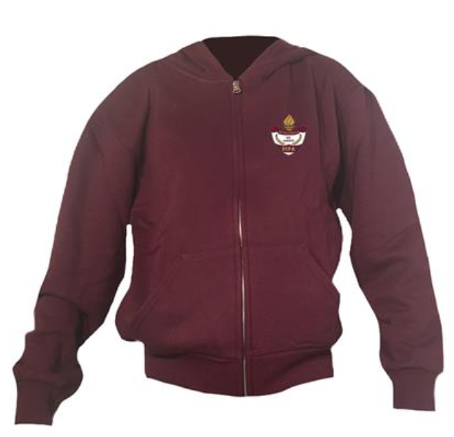
Dress Code Violations
A Somerset College Prep Polo must be worn underneath a zip up Hoodie or Jacket.
Exceptions would include
House Shirts on Thursday's
School Friday Shirts
Club Shirt Days
School Athletic apparel for game days.
Anyone not in compliance will be given a Dress Code Violation according to our Discipline Matrix.

Slide 9
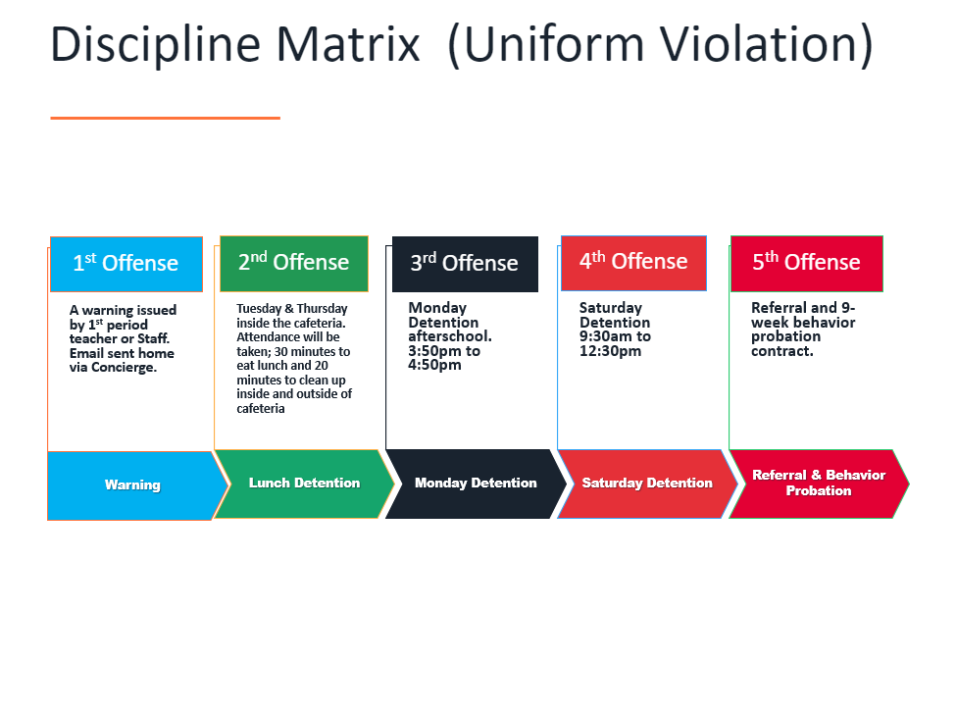

Slide 10
Discipline
Discipline is applied with mutual respect in a firm, fair , reasonable and consistent manner.
Preventive Morning announcements, Teacher and School's Rules & Expectations
Supportive Warnings for students to get back on task. Email notification to parents
Corrective Weekly Monday Detentions, Monthly Saturday Detentions

Slide 11
Somerset College Prep Discipline Matrix
*Warnings* Do Not apply to all discipline. Teacher & Staff discretion
DETENTION
SATURDAY DETENTION
SUSPENSION through DISMISSAL
3:50 to 4:50pm
Classroom Disruption
Disruptive Conduct
Chewing Gum
Bus Violation
Disrespect for others
Disrespect for property
Littering during lunch
Electronic Confiscation
Public Display of Affection / P.D.A
Profane Obscene Abusive Language
Running in the Halls
Spray used in the Restrooms
Tardy to Class
Tardy to School ( 3 late arrivals non bus rider)
9:30 to 12:30pm
Horseplay
Missed Detention
Multiple Detentions
Disruptive Conduct
Bus Violation
Skipping = 2 Saturday Detentions, Referral & 9 week Behavior Probation Contract
Cheating = 3 Saturday Detentions, Referral & Behavior Probation Contract
Excessive Detentions / Unserved Detention
Theft
False or Misleading Info
Open Defiance of Authority
Vaping
Physical Altercation
Fighting or Attempting to Fight
Assault / Intimidation Threat of Student
Weapons
Other Major Misconduct

Slide 12
DETENTION NOTICE AUGUST 2023
MONDAY 3:50 TO 4:50PM
AUGUST 21ST
AUGUST 28TH
SATURDAY 9:30 TO 12:30PM
AUGUST 26TH
LUNCH DETENTION
AUGUST 29TH (TUESDAY)
AUGUST 31ST (THURSDAY)

Slide 13




TURF DURING LUNCH
Volleyball
Monday-Friday: NO SPIKING!!!
Basketball
Monday / Wednesday: Highschool only
Tuesday / Thursday: Middle School only
Rotate Fridays
( Highschool has the 1st Friday of each Month)

Slide 14
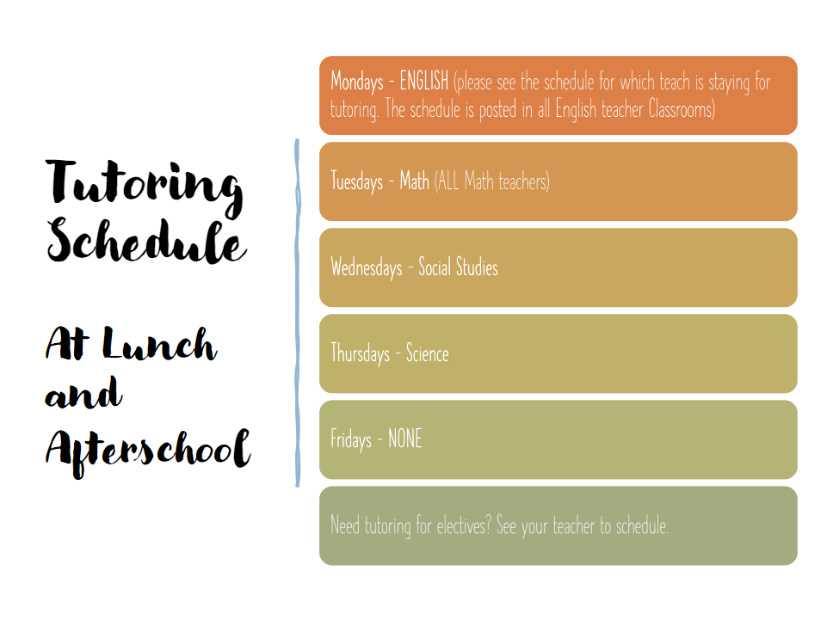

Slide 15

PTSO Meetings
Upcoming PTSO Meetings:
Meetings 6-7 in the SCPA Cafe
8/23 - Athletics and
Guidance
(Pappy's Pizza and Pot luck!)
9/20 - with Administration
10/18 - with Guidance
10/27 Trunk or Treat & Haunted House
11/11 Community Garage Sale
Somerset Clubs & Sports – it would be great to have one representative from each club & sport there to give updates & let parents know of your fundraising efforts & needs!
The PTSO can help you raise funds!
Teachers – please let Ms. Bowling know of any needs for your classroom or your fundraising efforts.
The PTSO can help you raise funds!
Email PTSO@SomersetCollegePrep.org with any questions!
House Points & Parent Volunteer Hours Awarded

Slide 16
PTSO Meeting Coming up!
Wednesday, August 23rd 6 pm in the Cafeteria
PAPPY'S PIZZA!
Have a chance to chat with
Somerset Athletics & Guidance!
House Points & Parent Volunteer Hours Awarded

Slide 17
Attention Upperclassmen College Entrance Exam Dates and Registration Deadlines:
TEST | TEST DATE | REGISTRATION DEADLINE
SAT | 10/7/2023 | 9/8/2023
SAT | 11/4/2023 | 10/5/2023
SAT | 12/2/2023 | 11/2/2023
ACT | 10/28/2023 | 9/22/2023
ACT | 12/9/2023 | 11/3/2023
When you register online, you may select your testing site. School Day SAT will be administered in March 2024.

Slide 18


Slide 19
Interested in starting a school club?
If you’re interested in starting a school club, you should do the following:
Find a teacher to sponsor the club. Give them the details about the club so they know if they’re able to sponsor the club.
Create a petition and get students who would be interested in your club to sign it. This shows that your club has generated interest.
Talk to someone in administration about getting your club approved. Tell them who the sponsor is, when the club will occur (lunch or afterschool), and what the club entails.
Email Mr. Kyryliw (Kyryliw.Michael@somersetcollegeprep.org) the information about you club and a slide advertising it. I will leave the advertising slide up for a week or so and create a slide listing all the club information for easy reference.

Slide 20


Slide 21
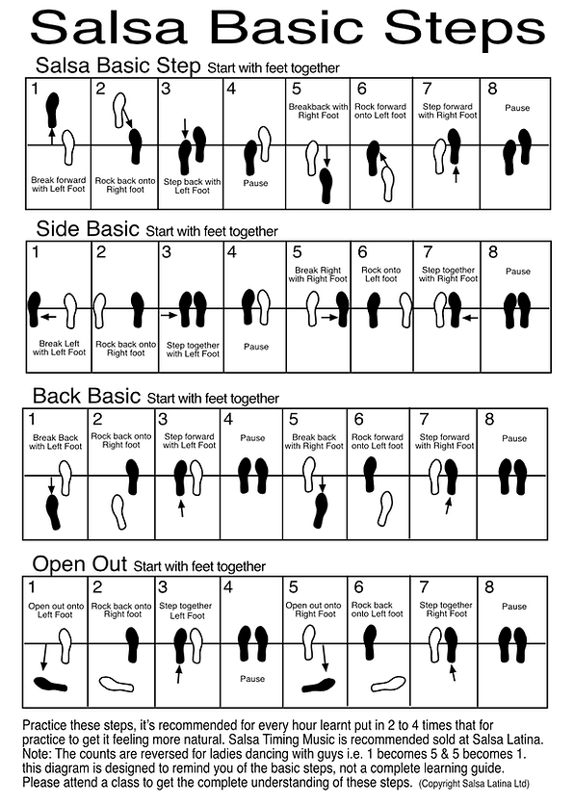

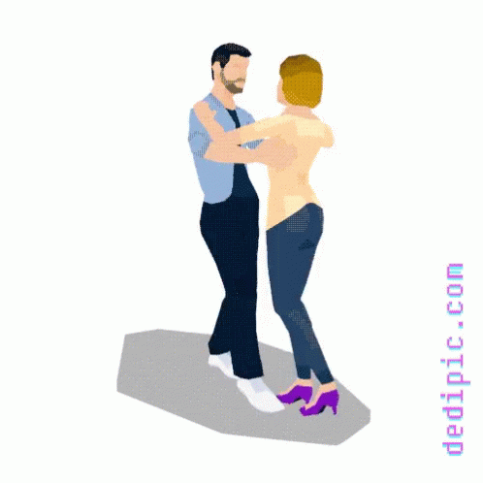

Do you want to learn how to dance Salsa, Merengue, Bachata?? Join us during lunch in room 136 every Tuesday and Thursday.
No experience necessary…..but come only to participate, not observe.
No continuous attendance required….learn as much or as little as you want.
See you there! (begins 8/22/23)

Slide 22


Slide 23
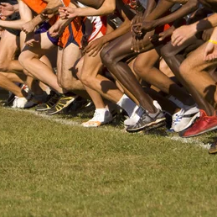
Cross Country is open and accepting runners!!
Practice on Mondays, Wednesdays, and Thursdays after school 4:30-5:00
Room 131
Great and super fun opportunity!

Slide 24
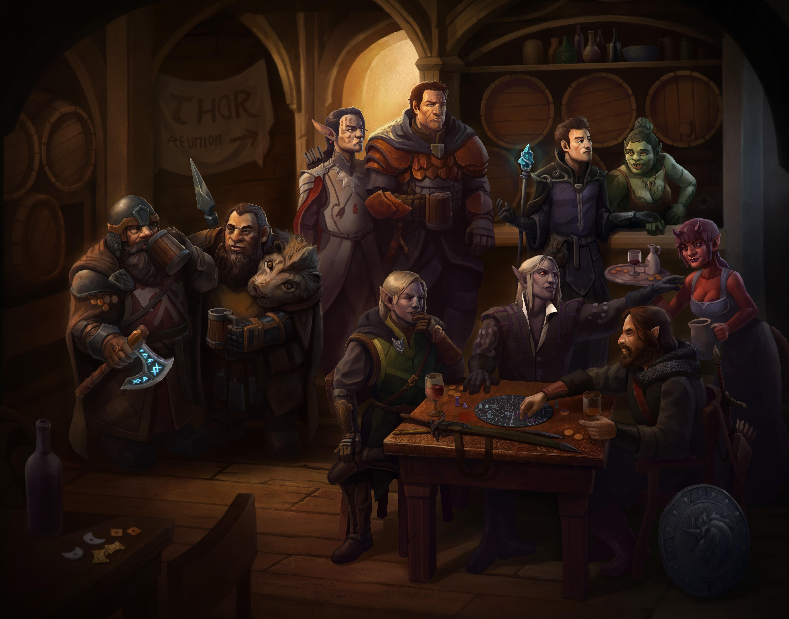
D&D Club
If you have an interest in participating with D&D Club, sign the D&D club interest sheet in front of Room 175
When: Mondays
Time: 4:00 – 5:15
Where: Room 175

Slide 25


Slide 26


Slide 27


Speak like thunder, Strike like lightning.

Slide 28

For a true hero isn't measured by the size of his strength, but by the strength of his heart.

Slide 29





House Reminds
For anyone who needs the house remind this year ☺ This is important for communication with your house head.
Ares-@houseare
Athena-@scpaathena
Hestia- @househes
Poseidon- @psdnscpa
Zeus-@housezeus

Slide 30

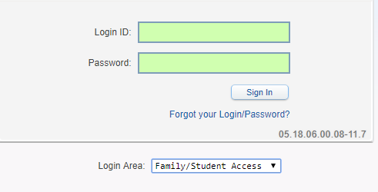
Student Skyward Access
Login ID: (Student 562#)
Password: (8 Digit Birthdate - MMDDYYYY)
Example: 08032005
**You May access Skyward through the school’s website.

